Slide 1

Using MsPASS for Seismology Data Processing
Intro to HPC Systems
Ian Wang

Slide 2
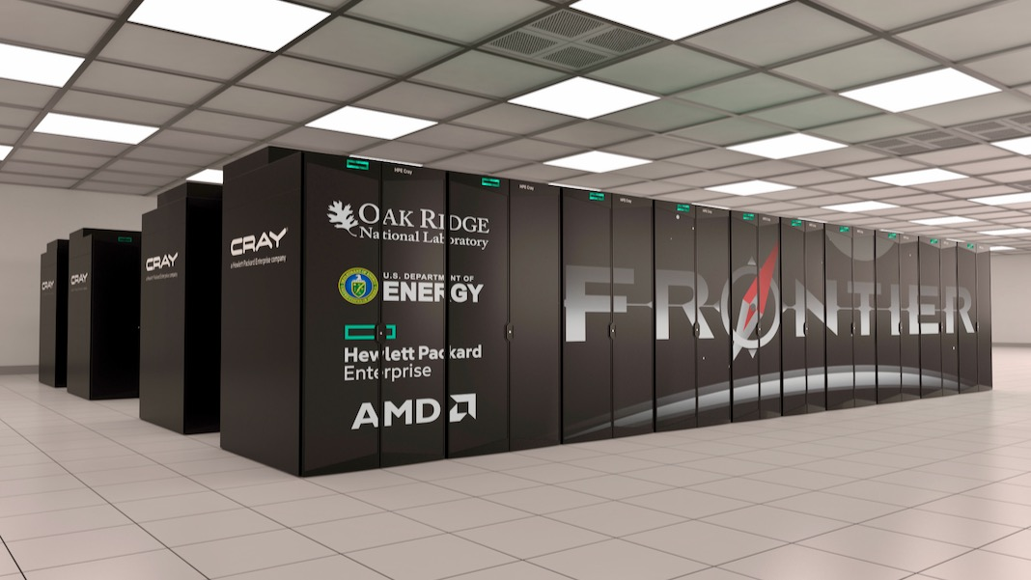
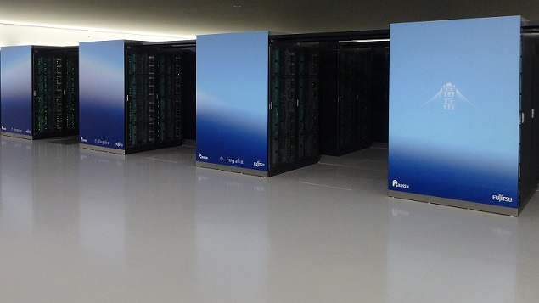
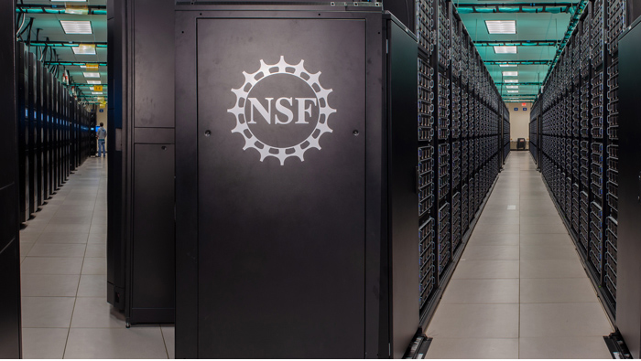
Supercomputer
Notes:
Fugaku #1, Summit #2, Frontera #10

Slide 3
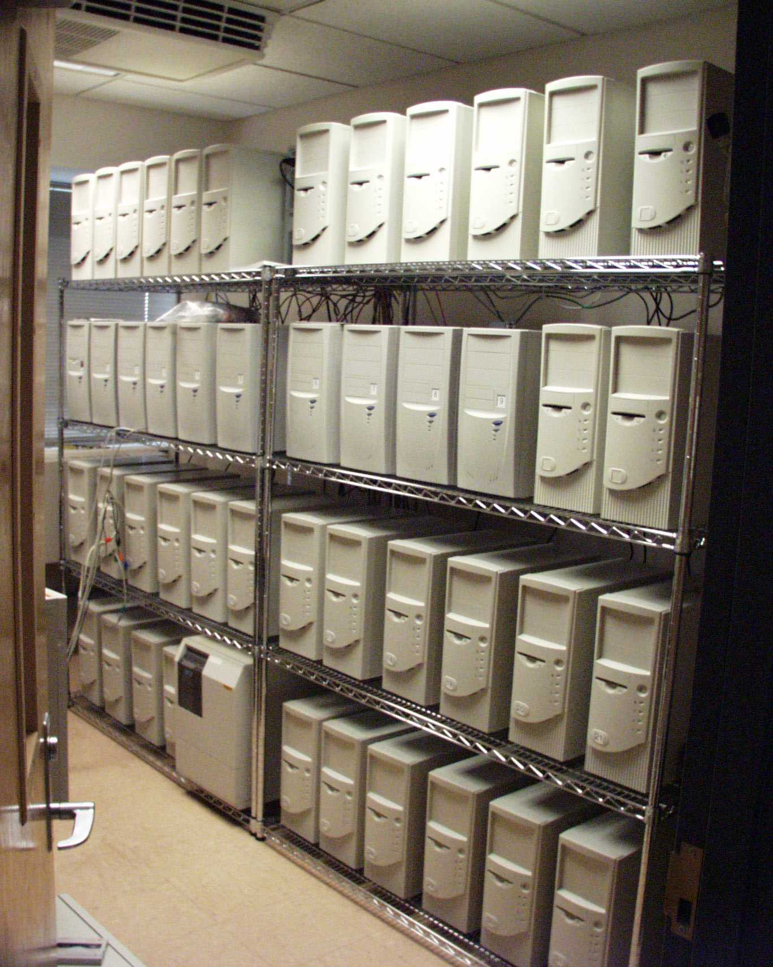
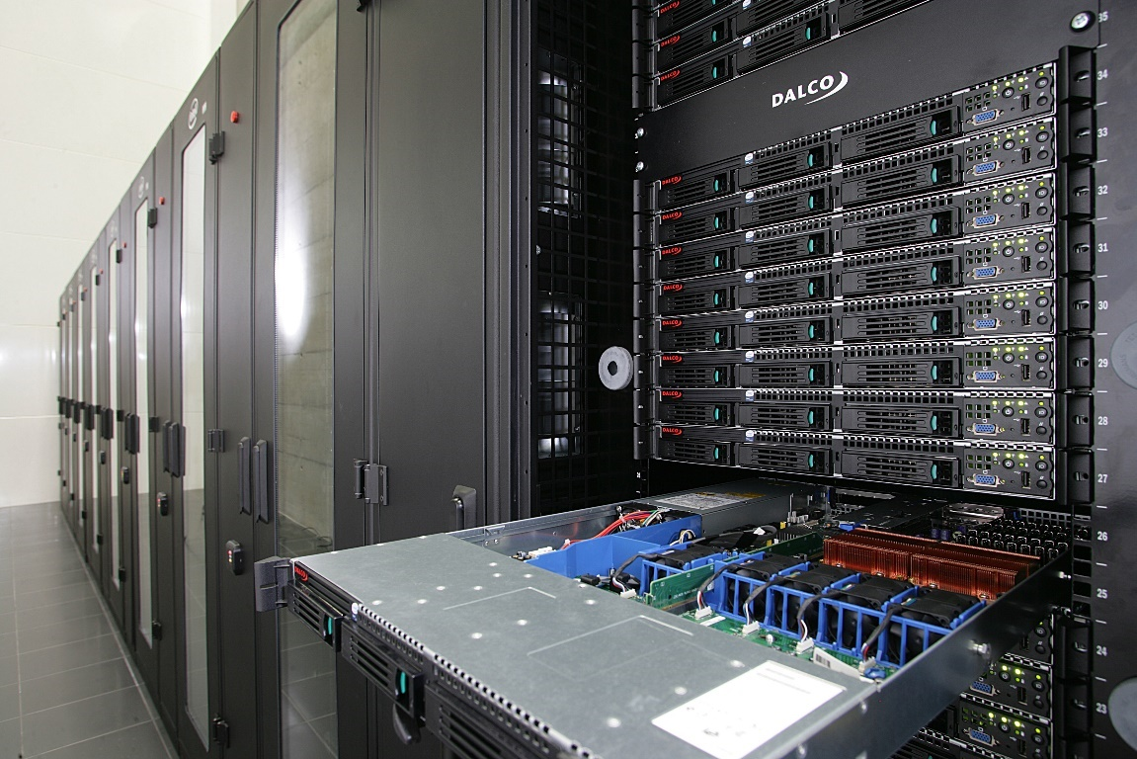
Supercomputer

Slide 4
Top500 Ranking
Rank | Site | System | Cores | Rmax (PFlop/s) | Rpeak (PFlop/s) | Power (kW)
1 | National Supercomputing Centre in Shenzhen (NSCS) China | LineShine - LingKun, LX2 304C 1.55GHz, LingQi, Kylin OS | 13,789,440 | 2,198.40 | 2,735.82 | 42,220
2 | DOE/NNSA/LLNL United States | El Capitan - HPE Cray EX255a, AMD 4th Gen EPYC 24C 1.8GHz, AMD Instinct MI300A, Slingshot-11, TOSS, HPE | 11,340,000 | 1,809.00 | 2,821.10 | 29,685
3 | DOE/SC/Oak Ridge National Laboratory United States | Frontier - HPE Cray EX235a, AMD Optimized 3rd Generation EPYC 64C 2GHz, AMD Instinct MI250X, Slingshot-11, HPE Cray OS, HPE | 9,066,176 | 1,353.00 | 2,055.72 | 24,607
 | Maybe on your desk | High-end GPU workstation - 24-core CPU, NVIDIA GeForce RTX 5090 | 24 CPU cores 170 GPU SMs |  | 0.00164 | ~1.0
Notes:
https://www.intel.com/content/dam/support/us/en/documents/processors/APP-for-Intel-Core-Processors.pdf

Slide 5
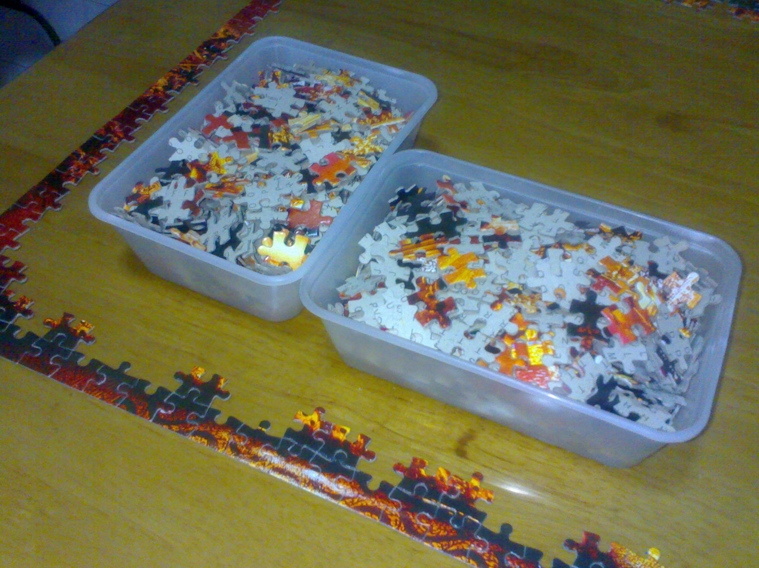
Shared Memory
All cores share a common pool of memory (RAM)
The programming challenge is coordination: how to avoid competing for access to the same puzzle pieces (memory)
A single executable spawns independent threads and manages threads' access to data
Memory (RAM)
Core
Core
Core
Core
Core
Core

Slide 6
Distributed Memory
Each core has its own memory (RAM), inaccessible to other cores
The programming challenge is communication: how to share puzzle pieces (data)
Every assigned core runs a separate copy of the same executable -- a “rank aware” task
RAM
RAM
RAM
RAM
RAM
RAM
Core
Core
Core
Core
Core
Core
Network
6

Slide 7
Levels of Parallelism
Node n
Node 0
…
Switch
…
Node 1
Multinode
Socket 0
Socket 1
Multisocket
Core 0
…
Core m
Core 0
…
Core m
Multicore
SMT 0 SMT 1 SMT 0 SMT 1 SMT 0 SMT 1 SMT 0 SMT 1
0 1 2 3 4 5 6 7
Simultaneous multithreading
Logical Core #

Slide 8
HPC Configuration of MsPASS
Options
  Python package
    Conda or pip install can work
    Infamous package incompatibilities worse on giant systems
    Requires running auxiliary services (MongoDB and dask) that can be problematic
    Recommended only for development and advanced users
  Containerized – recommended approach
    Shell batch setup (legacy – no longer recommended)
    Python launcher (what we will use today)
For either option need to understand service model (next topic)

Slide 9
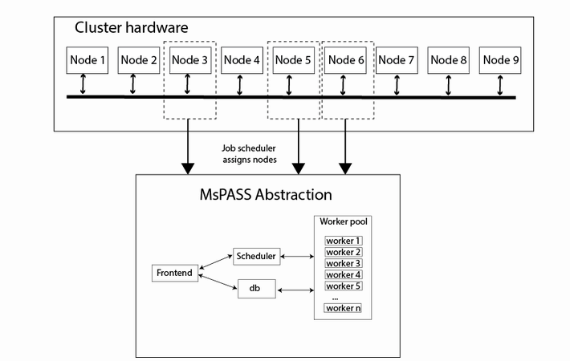
MsPASS Service model and HPC
MsPASS Services
scheduler
worker(s)
db
frontend

Slide 10
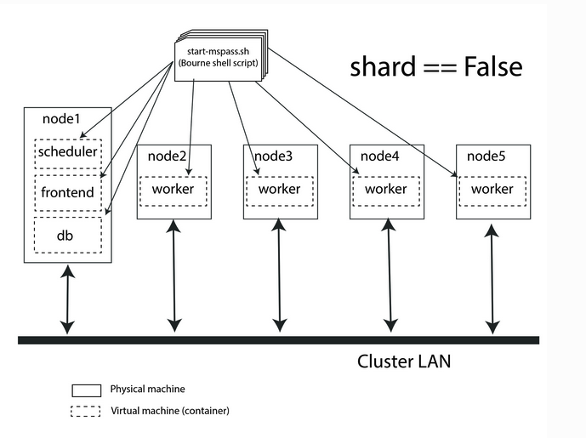
Container example
Points about this figure:
Each dashed box is a service
Each solid box is a compute node
Containers are an implementation detail
start script (top)
  Run when container launched
  Same virtual machine runs in different “roles” == service
From MsPASS User's Manual HPC configurations section

Slide 11
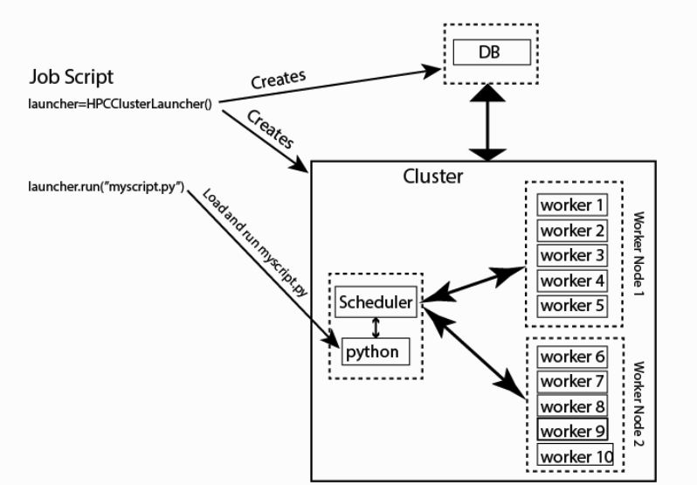
HPCClusterLauncher

Slide 12
Measuring Scalability

Slide 13
How fast can we bake a cake?
Assume (with no claim of realism)…
    Two hours to prepare the cake for baking
    Another half hour to bake the cake
So total time is…
    Prep: 120 minutes
    Bake: 30 minutes
    Total: 150 minutes

Slide 14
How fast can we bake a cake?
But what if we have two cooks?
    Assume they work perfectly together
    No wasted time, no overhead
Then total time is…
    Prep: 120/2 = 60 minutes
    Bake: 30 minutes
    Total: 90 minutes

Slide 15
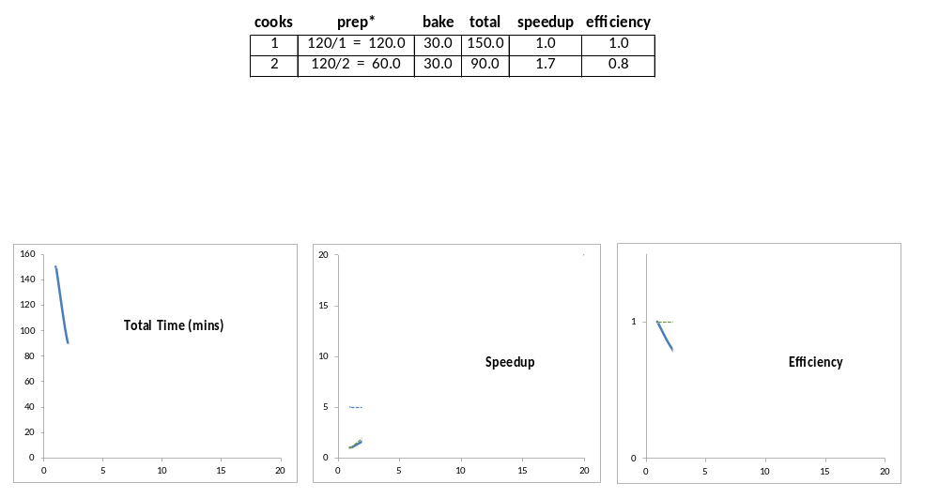
How fast can we bake a cake?

Slide 16
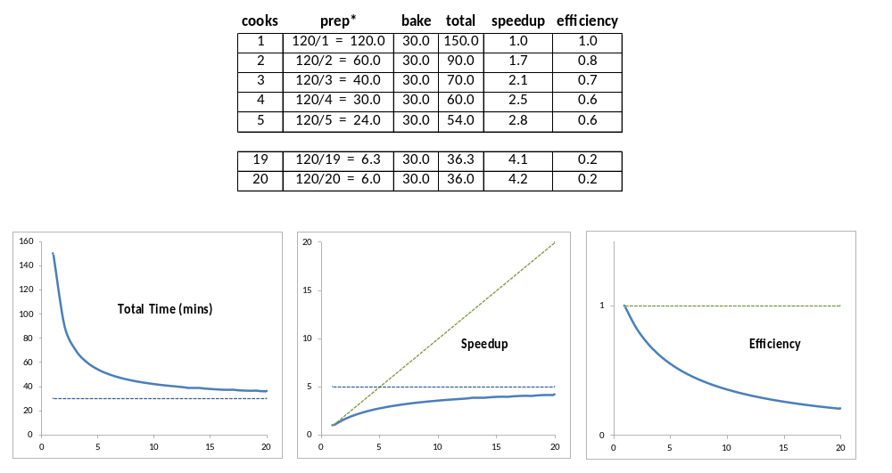
How fast can we bake a cake?

Slide 17
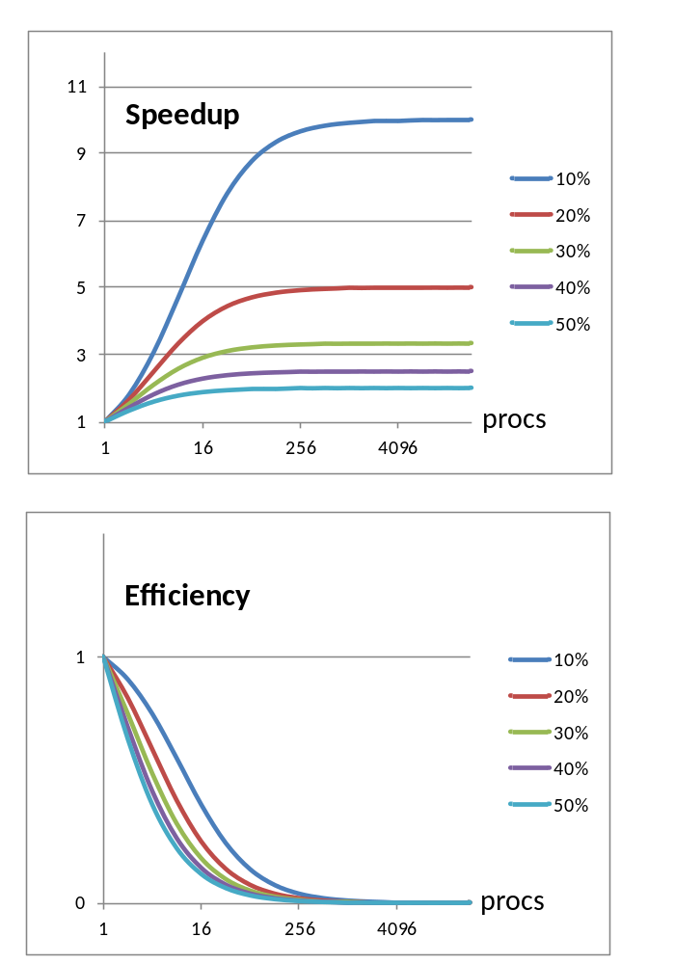
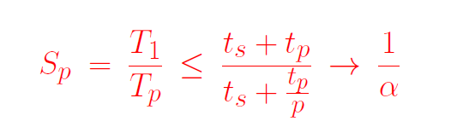
Amdahl's Law: Strong Scaling
Back-of-napkin scalability bounds
serial
fraction
serial
fraction

Slide 18
Amdahl's Law: Strong Scaling
Back-of-napkin scalability bounds
serial
fraction
actual
speedup
reciprocal of
serial fraction
perfect on
parallel section
serial
fraction
infinitely fast
on parallel section

Slide 19
Amdahl's Law: Strong Scaling
Back-of-napkin scalability bounds
Under reasonable assumptions…
  Serial fraction is a severe constraint
  As you add processors, you reach a point of diminishing returns
  Can't run faster than serial time
  Speedup bounded by reciprocal of serial fraction
serial
fraction
serial
fraction

Slide 20
Thank you!

